Slide 1
Spark Foundation
Data Science and Business Analytics
Task – 2 - Prediction Using Unsupervised ML(Clustering Methord)
Presented By – Abhijeet Rajwade

Slide 2
Prediction Using Unsupervised ML
Machine learning – Using Clustering
Language – Python
Libraries Used - Pandas, NumPy, Sklearn, Matplotlib, Seaborn
Dataset Using – IRIS DataSet

Slide 3
Clustering in Machine Learning
Clustering in Machine Learning - Clustering or cluster analysis is a machine learning technique, which groups the unlabelled dataset.
Defined as - A way of grouping the data points into different clusters, consisting of similar data points. The objects with the possible similarities remain in a group that has less or no similarities with another group
The clustering technique is commonly used for statistical data analysis.

Slide 4
Uses and Applications of Clustering Technique
The clustering technique can be widely used in various tasks. Some most common uses of this technique are:
Market Segmentation
Statistical data analysis
Social network analysis
Image segmentation
Anomaly detection, etc.
Applications of clustering technique in Machine Learning
In Identification of Cancer Cells
In Search Engines
Customer Segmentation
In Biology
In Land Use

Slide 5
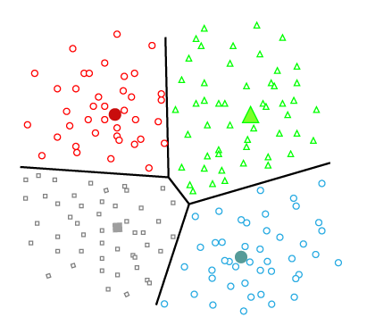
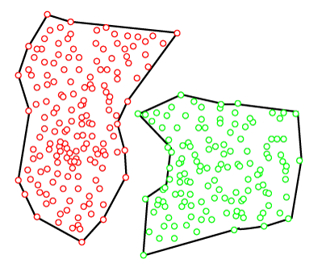
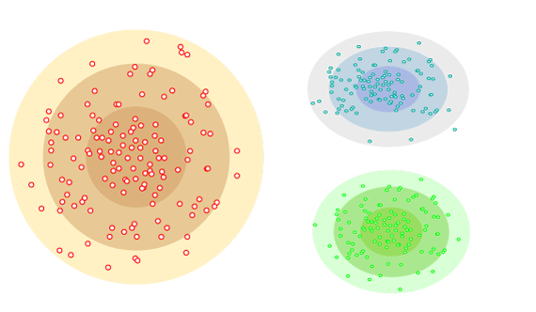
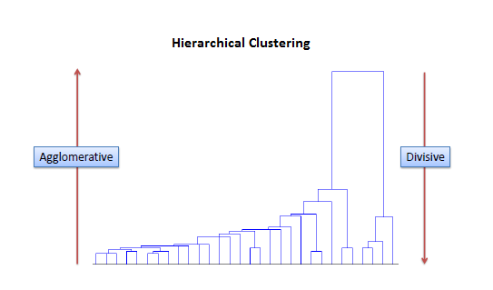
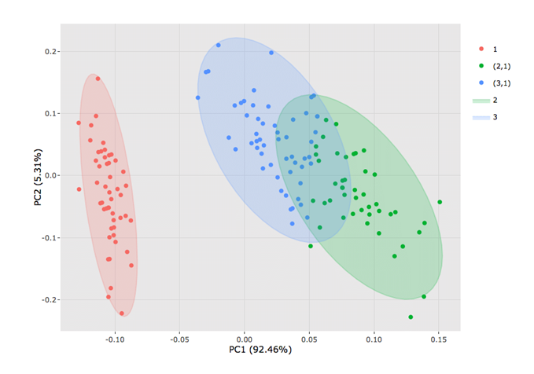
Types of Clustering Methods
Partitioning Clustering
Density-Based Clustering
Distribution Model-Based Clustering
Hierarchical Clustering
Fuzzy Clustering

Slide 6
Elbow Method
The Elbow method is one of the most popular ways to find the optimal number of clusters. This method uses the concept of WCSS value. WCSS stands for Within Cluster Sum of Squares, which defines the total variations within a cluster. The formula to calculate the value of WCSS (for 3 clusters) is given below:
WCSS= ∑_{Pi in Cluster1} distance(P_{i} C₁)² +∑_{Pi in Cluster2}distance(P_{i} C₂)²+∑_{Pi in CLuster3} distance(P_{i} C₃)²
In the above formula of WCSS,
∑_{Pi in Cluster1} distance(P_{i} C₁)²: It is the sum of the square of the distances between each data point and its centroid within a cluster1 and the same for the other two terms

Slide 7
Steps Involved :-
Importing the dataset
Visualizing the data
Finding the optimum number of clusters
Applying k means clustering on the data
Visualizing the clusters

Slide 8
Let see the coding in Jupiter Notebook for Clustering.

Slide 9
Thank You...
Please Post in comment section for any Queries and Suggestions.....

